Slide 1
COSP230 Ch. 11
Persistent Data

Slide 2
Persistent Data
Data that is permanently stored by an Android app by placing it into an XML file.
This is done through Shared Preferences
Can save all types of primitive data (ints, floats, Booleans, Strings)
Can save user preferences (wallpaper used, etc)
Usually works as a name-value pair
Descriptive name for data
Actual value
Must complete these steps
Create an instance of the SharedPreferences file
Create a SharedPreferences.Editor object
Assign values into editor object using any put method (putInt(), putFloat(), putBoolean(), putString())
Save values to file by using the commit() method

Slide 3
Other ways to save data from an app
Using Internal Storage
Files saved on device’s internal drive
Saved files only available to the app that created the files.
Using External Storage (USB Drive, SD card, etc)
Need WRITE_EXTERNAL_STORAGE and READ_EXTERNAL_STORAGE in AndroidManifest.xml
Using SQLite Databases
SQLite is embedded into user’s program or browser
Stored data persists even after app is terminated
Using a Network Connection
Data stored in a web service
If no connection available, data cannot be saved or retrieved

Slide 4
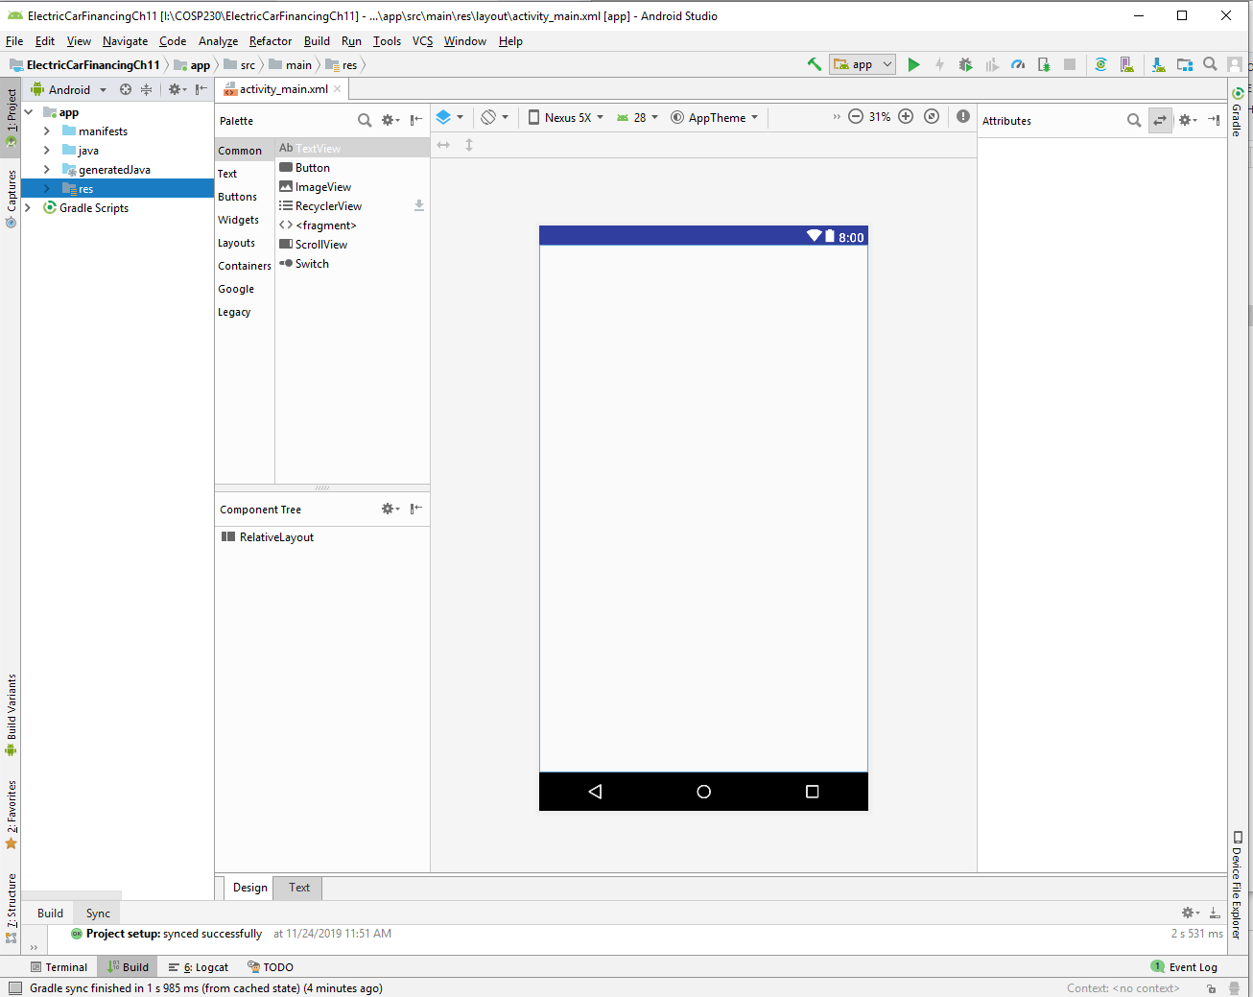
Start of Project (Delete HelloWorld text, select Nexus 5, change to Relative Layout):

Slide 5
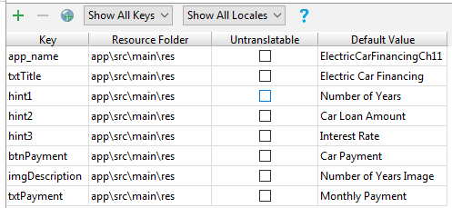
Add keys in Translations Editor
Open the Translations Editor
Add the keys in the table on the right:

Slide 6
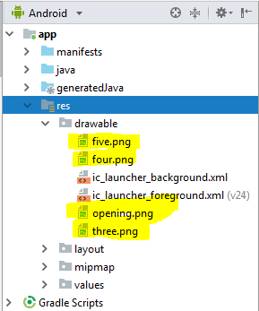
Add graphic files to drawable folder
Download the image files from the Ch Ten Images folder (Northern Lights subfolder)
Copy and paste the highlighted files into the drawable folder

Slide 7
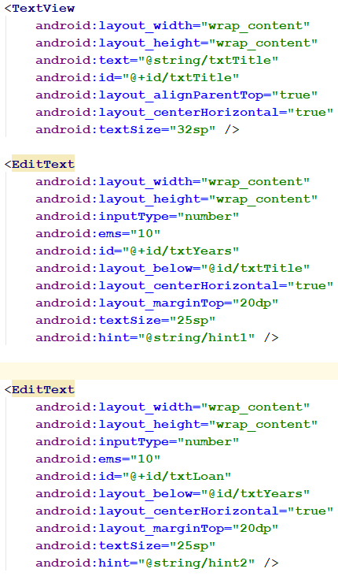
Update activity_main.xml, Part 1
Click the Text tab for activity_main.xml
Add the following code between the <RelativeLayout> and </RelativeLayout> tags (continued on next slide)

Slide 8
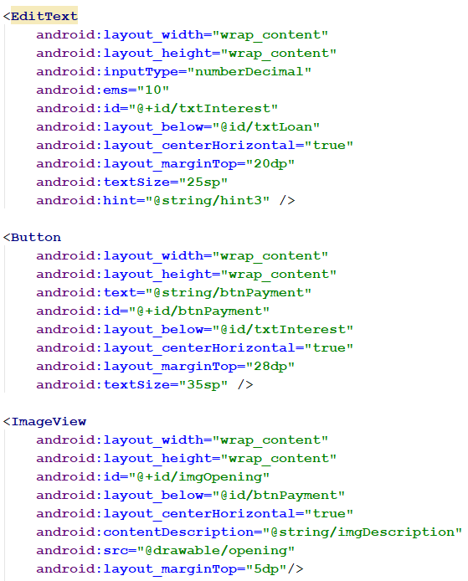
Update activity_main.xml, Part 2
Click the Text tab for activity_main.xml
Add the following code between the <RelativeLayout> and </RelativeLayout> tags (after code on previous slide)

Slide 9
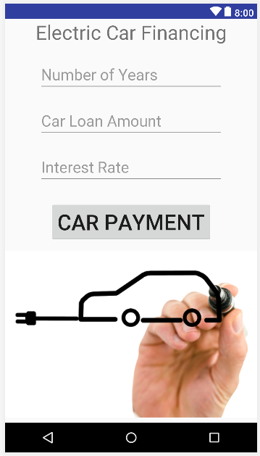
MainActivity should look like this:

Slide 10
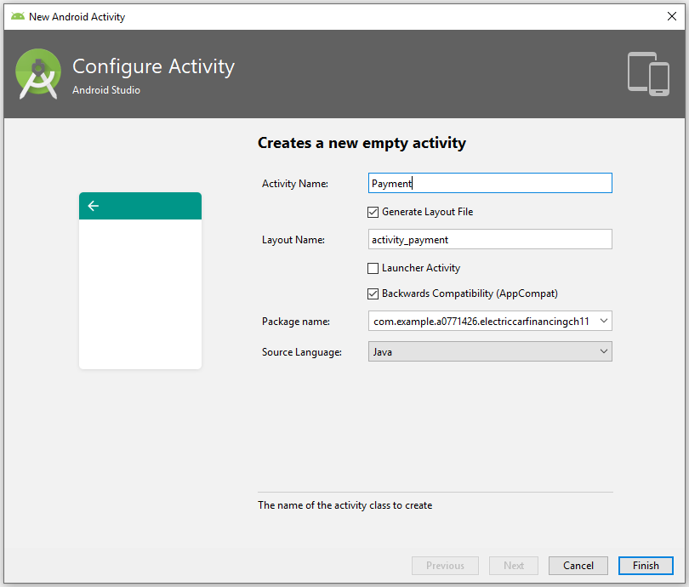
Create a second activity named Payment
Expand the java folder
Right-click the first com.example that has the project name and nothing in parentheses
In the menus, select the following:
New->Activity->Empty Activity
Fill out the Configure Activity window like the example on the right and click Finish

Slide 11
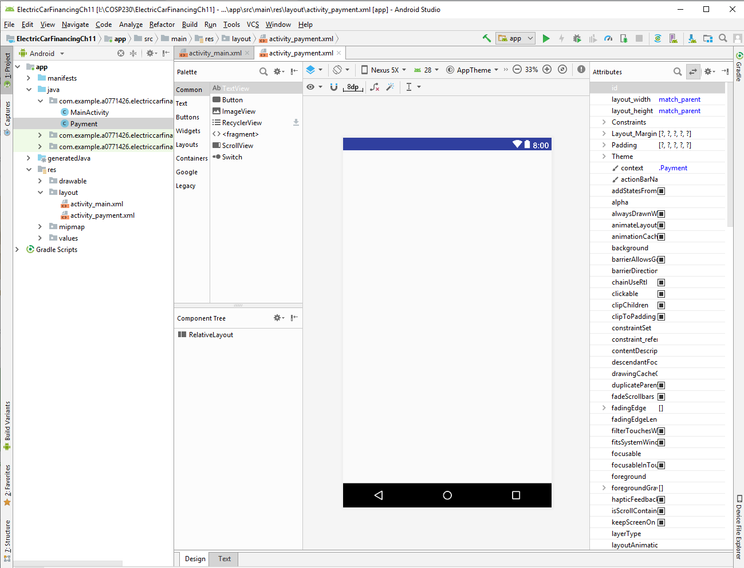
Convert activity_payment.xml to a Relative Layout and get this:

Slide 12
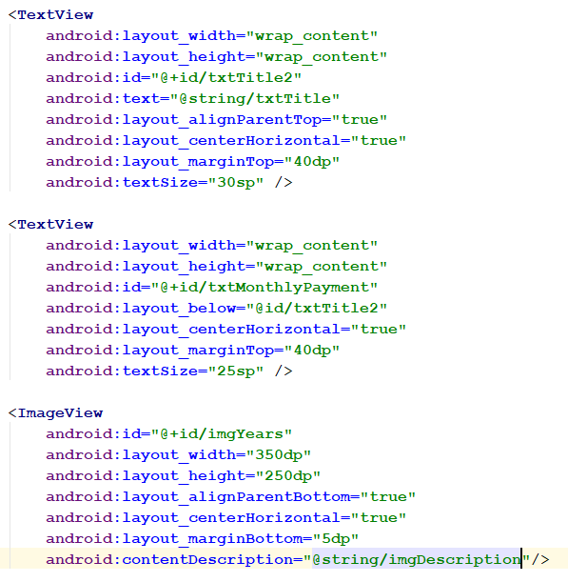
Update activity_payment.xml
Click the Text tab for activity_payment.xml
Add the following code between the <RelativeLayout> and </RelativeLayout> tags

Slide 13
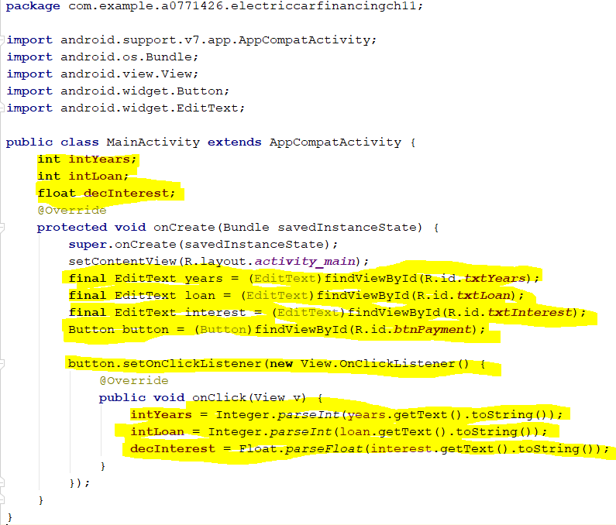
Update java code in MainActivity.java, Part 1
Add the highlighted lines of code
The three variables come after the public class MainActivity line
Everything else must come after the setContentView line in the onCreate method.
The onClick method will create itself once you finish the signature for the button.setOnClickListener method

Slide 14
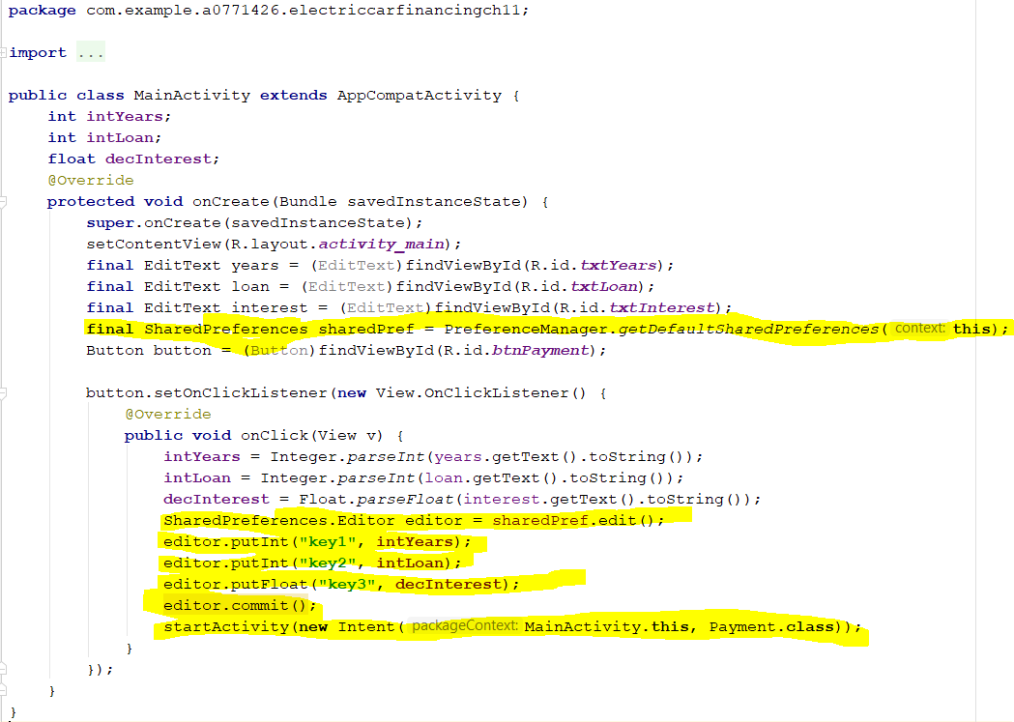
Update java code in MainActivity.java, Part 2
Add the highlighted lines of code, which do the following:
Create a SharedPreferences object to store data from this activity to use in another activity
Create a SharedPreferences editor, which is required add, modify, or delete content.
Methods that start with put (putInt(), putFloat(), etc) add data to the editor. Can add Boolean and String data as well.
remove() method removes a specific preference
clear() method removes all preferences
commit() method writes data to an XML file.
startActivity() method starts the Payment activity.

Slide 15
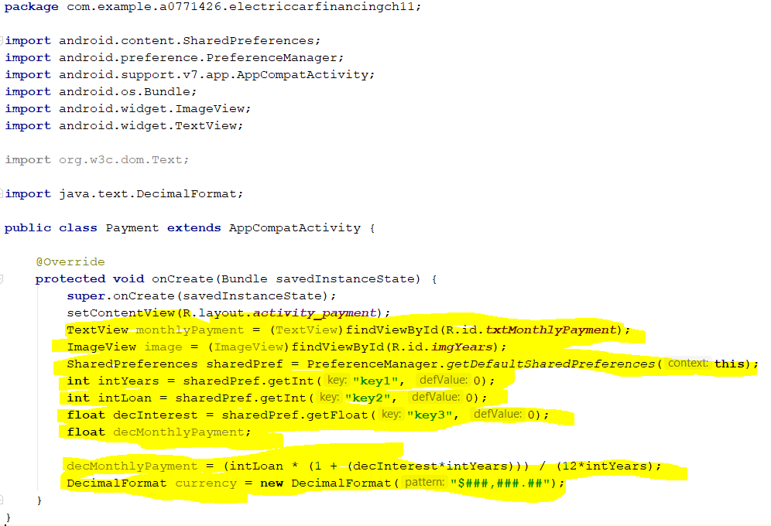
Update java code in Payment.java, Part 1
Add the highlighted lines of code
Methods that start with get (getInt(), getFloat(), etc) retrieve data from an XML file
Do not need an editor to call get methods.

Slide 16
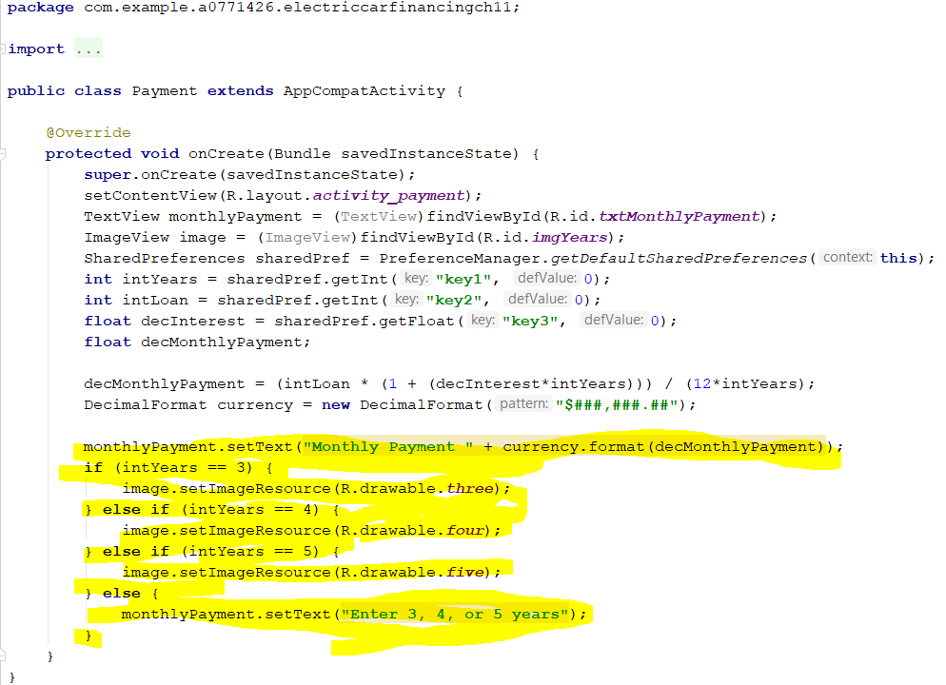
Update java code in Payment.java, Part 2
Add the highlighted lines of code

Slide 17
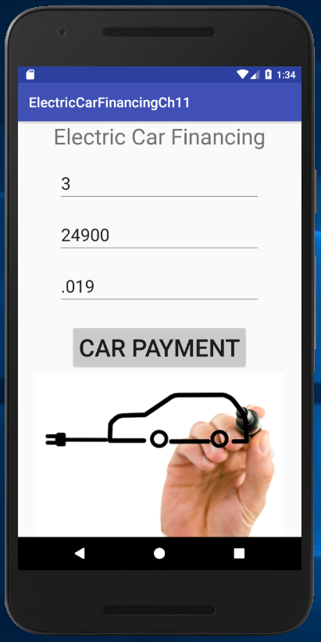
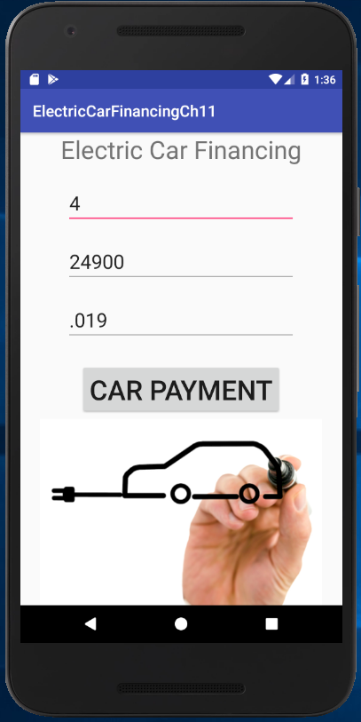
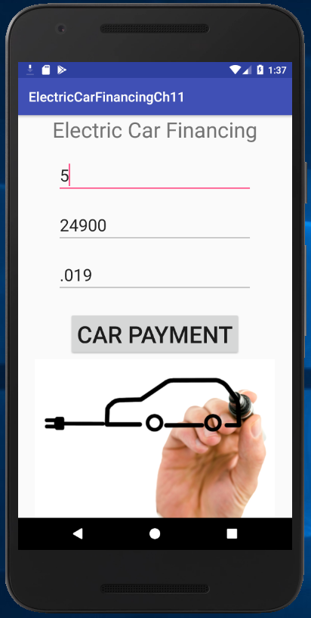
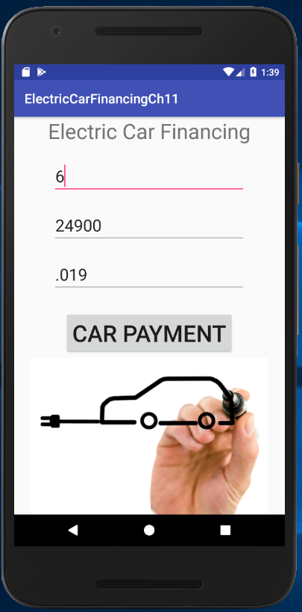
Run the app and enter the following inputs:

Slide 18
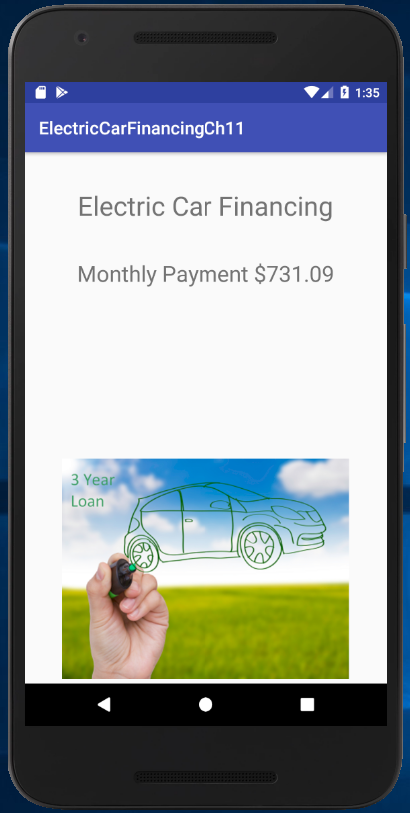
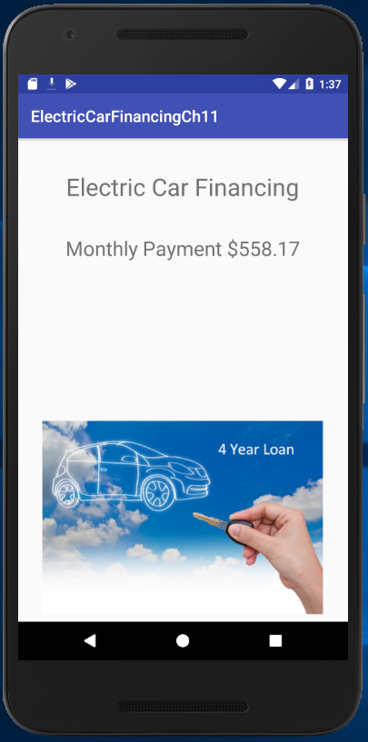
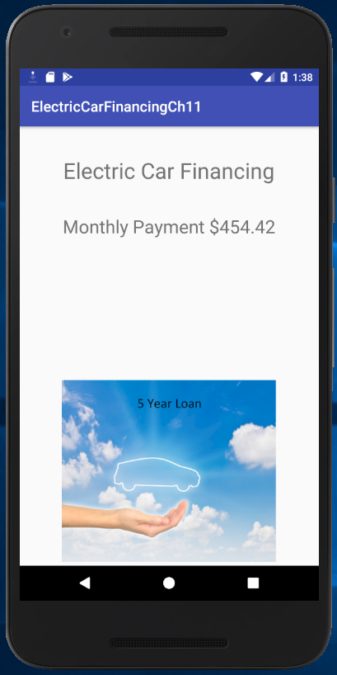
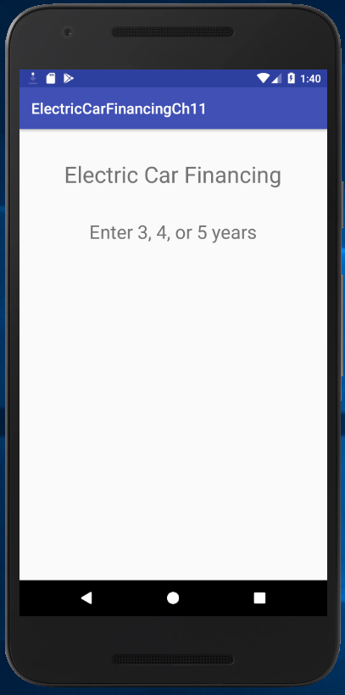
Here is each output:

